Slide 1

Understanding Coffee Quality with CQI Data
Exploring Sensory Attributes, Processing Methods, and Defect Occurrences
Mr. Anand Ramavarapu

Slide 2

Introduction to the Coffee Quality Institute (CQI), It was founded in 1996 and has its headquarters in California, USA.
CQI's mission is to promote coffee quality through a range of activities that include research, training, and certification programs.

Slide 3
Importance of coffee quality in the industry
The organization works with coffee growers, processors, roasters, and other stakeholders to improve coffee quality standards, promote sustainability, and support the development of the specialty coffee industry.

Slide 4
The objectives of the project
The primary goal of this project is to leverage the rich dataset provided by CQI to understand the factors that contribute to coffee quality.

Slide 5

Data Overview
The data includes a range of information on coffee production, processing, and sensory evaluation. It also contains data on coffee genetics, soil types, and other factors that can affect coffee quality.

Slide 6
Sensory evaluations (coffee quality scores)
Aroma: Refers to the scent or fragrance of the coffee.
Flavor: The flavor of coffee is evaluated based on the taste, including any sweetness, bitterness, acidity, and other flavor notes.
Aftertaste: Refers to the lingering taste that remains in the mouth after swallowing the coffee.
Acidity: Acidity in coffee refers to the brightness or liveliness of the taste.
Body: The body of coffee refers to the thickness or viscosity of the coffee in the mouth.
Balance: Balance refers to how well the different flavor components of the coffee work together.
Uniformity: Uniformity refers to the consistency of the coffee from cup to cup.
Clean Cup: A clean cup refers to a coffee that is free of any off-flavors or defects, such as sourness, mustiness, or staleness.
Sweetness: It can be described as caramel-like, fruity, or floral, and is a desirable quality in coffee.
PLEASE NOTE: 'Total Cup Points' is literally the total of 10 features given above. There were some notebooks trying to predict the total cup points given these features. We know the exact function underlying the total cup points.

Slide 7
Defects:
Defects are undesirable qualities that can occur in coffee beans during processing or storage. Defects can be categorized into two categories: Category One and Category Two defects.
Category One defects are primary defects that can be perceived through visual inspection of the coffee beans. These defects include Black beans, sour beans, insect-damaged beans, fungus-damaged beans, etc.
Category Two defects are secondary defects that are more subtle and can only be detected through tasting. These defects include Over-fermentation, staleness, rancidness, chemical taste, etc.

Slide 8
Key Research Questions
What are the key determinants of coffee quality as evaluated through sensory attributes?
Is there a correlation between processing methods, origin regions, and coffee quality scores?
Identifying trends in defect occurrences and their impact on overall coffee quality.
Understanding the interaction between different variables influencing Total Cup Points.

Slide 9

Methodology
Import the dataset into Power BI using appropriate data connectors.
Perform data cleaning tasks such as handling missing values, removing duplicates, and ensuring consistency in data formats.
Validate the integrity of the dataset to ensure accuracy in subsequent analyses.

Slide 10
Key Determinants of Coffee Quality
Results of analysis on sensory attributes (aroma, flavor, acidity, etc.)
Highlight significant factors contributing to coffee quality

Slide 11
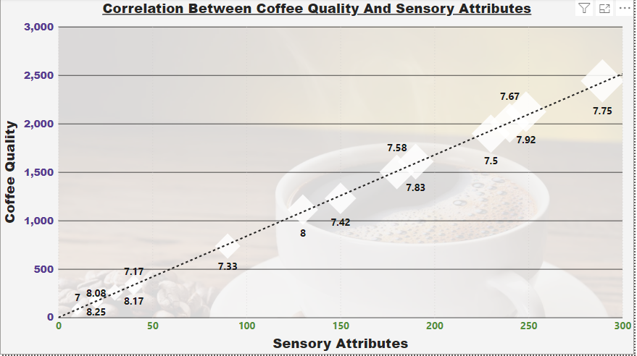
Key Determinants of Coffee Quality

Slide 12
Correlation Analysis
Correlation between processing methods, origin regions, and coffee quality scores
Visualizations (e.g., heatmaps, scatter plots) illustrating relationships

Slide 13
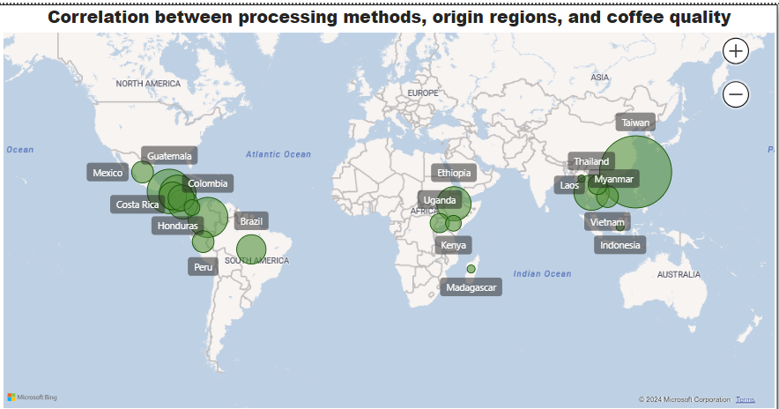
Correlation Analysis

Slide 14

Trends in Defect Occurrences
Analysis of defect occurrences and their impact on coffee quality
Identification of common defects and their prevalence

Slide 15
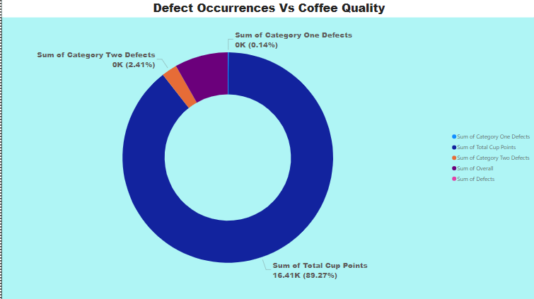
Trends in Defect Occurrences

Slide 16

Influence of Variables on Total Cup Points
Insights into how different variables interact to influence Total Cup Points
Visualizations showing the relationship between variables and Total Cup Points

Slide 17
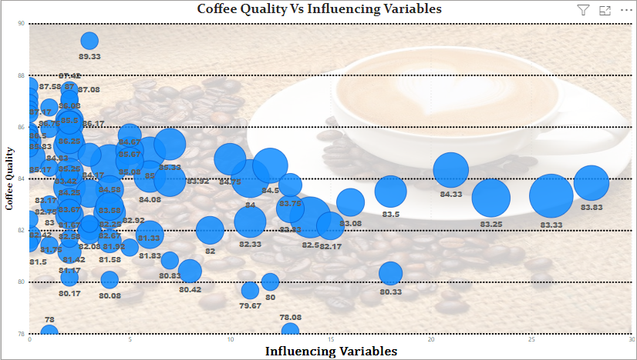
Influence of Variables on Total Cup Points

Slide 18
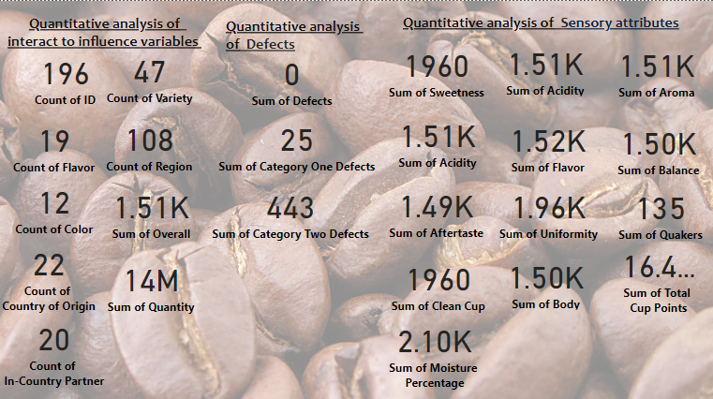
Quantitative analysis Of Dataset

Slide 19
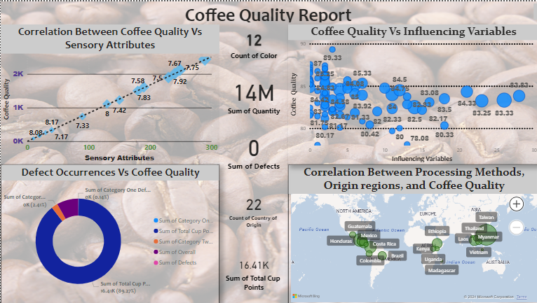
Coffee Quality Report

Slide 20
Acknowledgments
Thank CQI for providing the dataset

